Slide 1
Remaining Part of Singleton Pattern and Then State and Composite Patterns
Lect 21
10-10-2023

Slide 2
Singleton: Example Code
  Public Class Singleton {
  private static Singleton uniqueInstance = null;
  // Why is uniqueInstance static?
  private Singleton( ) { .. } // private constructor
  public static Singleton getInstance( ) {
  if (uniqueInstance == null)
  uniqueInstance = new Singleton();
  return uniqueInstance;
  }
  }

Slide 3
Exercise 1
Objects in a certain application:
  Get a Database Manager: DBMgr.getDBMgr();
It needs to be ensured that:
  There is only one Database Manager object.
  Need to disallow creation of more than one object of this class.

Slide 4
Exercise 1 -- Solution
class DBMgr {
private static DBMgr pMgr=null;
private DBMgr() { } // No way to create outside of this Class
public static DBMgr getDBMgr() { // Only way to create.
if (pMgr == NULL) pMgr = new DBMgr();
return pMgr;
}
public Connection getConnection(); }
}
Usage:
DBMgr dbmgr = DBMgr.getDBMgr();
//Created first time called

Slide 5
Why not just use a static method?
Why have all the complexity of Singleton?
  Why is a static method with private constructor not enough?
  public class DBMgr{
  private static DBMgr d= DBMgr();
  public static DBMgr getDBMgr(){
  return d;} }
Problem 1: lacks flexibility
  Static methods can't be passed as an argument to a method, nor returned
Problem 2: cannot be extended
  Static methods can't be subclassed and overridden like a singleton's could be.

Slide 6
Exercise 1: Random Number Generator
  public class RandomGenerator {
  private static RandomGenerator gen = new RandomGenerator();
  public static RandomGenerator getInstance() {
  return gen;
  }
  private RandomGenerator() {}
  public double nextNumber() {
  return Math.random();
  }
  }
Fill Code Here…
Any Possible problem?
  Always creates the instance, even if it isn't used…

Slide 7
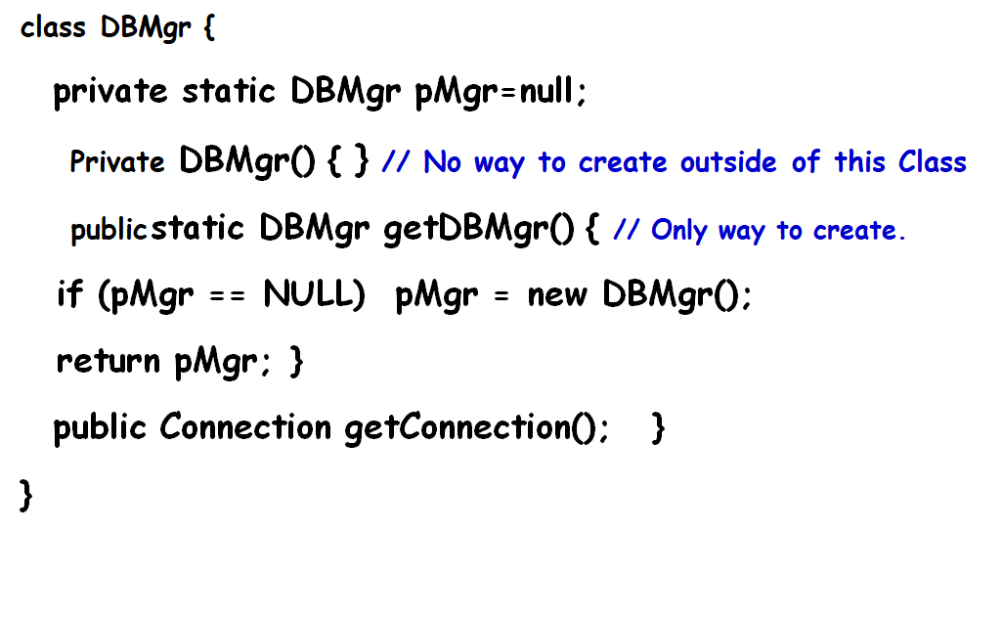
Singleton Pattern: Some Insights
Singleton with lazy instantiation:
  The singleton instance is not created until the instance() method is called for the first time.
  Ensures that singleton instance is created only when needed.
rotected constructor can be called by subclasses.

Slide 8
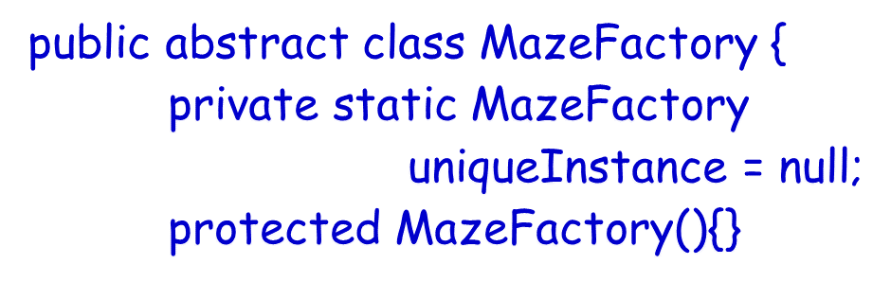
Singleton Pattern: Some Insights
Singleton subclassing: Singleton needs to implement a protected constructor:
  Clients cannot directly instantiate Singleton instances through new.
  But, protected constructor can be called by subclasses.
rotected constructor can be called by subclasses.

Slide 9
Can Multiple Singletons Still Appear?
In certain situations, two or more Singletons mysteriously materialize:
  Disrupting the very guarantees that the Singleton is meant to provide.
Consider a web application being executed in a browser.
  Each servlet uses its own class loader.
  Static blocks are executed during the loading of class and even before the constructor is called.

Slide 10
Concurrent Executions…
// error as no synchronization on method
public static MySingleton getInstance() {
if (instance==null) {
instance = new MySingleton(); }
return instance;
}

Slide 11
Handling Concurrency Issue
// Correct solution
public static synchronized
MySingleton getInstance(){
if (instance==null) {
instance = new MySingleton(); }
return instance;
}

Slide 12
Refined code: without unnecessary locking
synchronized (RGen.class) is used here to make sure that there is exactly one Thread in the block..
public class RandomGenerator {
private static RandomGenerator gen = null;
public static RandomGenerator getInstance() {
if (gen == null) {
synchronized (RandomGenerator.class) {
// must test again -- can you see why?
if (gen == null)
gen = new RandomGenerator(); }
}
return gen;
}
}

Slide 13
Singleton Pattern: Variations
Multiton:
  We can easily change a Singleton to allow a small number of instances where this is allowable and meaningful.
  Operation that grants access to the Singleton instance needs to change.

Slide 14
final class Multiton{
private static final int COUNT = 10; // change to vary the number of instances
private static final Multiton[] INSTANCES = new Multiton[COUNT];
private static int index = 0;
static {
for (int i = 0; i < INSTANCES.length; i++) {
INSTANCES[i] = new Multiton();
}
}
private Multiton() {}
public synchronized Multiton getInstance(){// synchronized because of index
Multiton result = INSTANCES[index];
index = (index + 1) % INSTANCES.length;
return result;
}
}
Simple Multiton

Slide 15
Usage of Singleton in Other Patterns
Several patterns use Singleton Pattern for implementation.
  For instance AbstractFactory needs a singleton object for maintaining a single instance of the factory.

Slide 16
State Pattern

Slide 17

Introduction
An object is behaving differently to the same message. What could be the reason?
  Possibly the object is transiting to different states.
Example: Consider the responses to the “renew” request on a book:
    Successfully renewed
    Reserved, cannot be renewed
    Book needed for stock taking, cannot be renewed
    Already renewed five times, cannot be renewed …

Slide 18





State of an Object
One or more attributes of a class acts as state variables.
  Depending on the values of the state variables.
    -- Some methods exhibit different behavior.
An example:
  A person may behave differently depending on his mood.

Slide 19



State Example: Person
mad
angry
happy
doWork()
doWork()
doWork()
doWork()
Work destructively
Work badly
Work properly

Slide 20
State Pattern: Overview
A Behavioral pattern.
Allows an object to alter its behavior when its state changes.
  The object will appear to change its class.
To realize different behavior for different states of an object.
  Polymorphism is used.

Slide 21
Typical State Behavior Implementation
Class Person {
Mood state;
  doWork() {
  if (state == angry)
  doWorkBadly();
  else if (state == happy)
  doWorkProperly();
  }
  pleaseHelpMe() {
  if (state == angry)
  doScold();
  else if (state == happy)
  doHelp();
  }
….
}
Many things you do depend on your state of mind

Slide 22
State Design Pattern
Idea: Value of an internal state var determines Object behavior.
Intent:
  Allow an object to alter its behavior when value of its internal state variable changes.
  The object will appear to change its class.

Slide 23
Why Use A State Pattern?
The state pattern creates a separate class for each conditional branch.
  This eliminates if/else or switch/case statements.
Code is modular:
  Allows to easily change state behavior.

Slide 24
State Pattern Basic Approach:
Replace Conditionals by Inheritance
abstract class A{
doWork();
}
doWork() {
If (condition)
doWorkProperly()
else
doWorkBadly();
}
****IfCondition****
doWork(){ doWorkProperly();}
****ElseCondition****
doWork(){ doWorkBadly();}

Slide 25

Example: State Pattern Structure
Mood
Person
state
variable
doWork()
doWork()
mad
angry
happy
doWork()
doWork()
doWork()

Slide 26
State Pattern: Working
Client
{ targetState.handleRequest(); }
Target
targetState
doRequest()
TargetState
handleRequest()
1
TargetStateA
handleRequest()
TargetStateB
handleRequest()
. . . . . .

Slide 27
State Pattern: Players
Context class:
  It is the class which changes state.
  Context class maintains a reference to the current state object.
  To change the state,
    The reference object needs to be changed.
Abstract State class
Concrete State classes:
  Define the changed behavior in states.
Context
AbsState
state variable
request()
handle()
Concrete State 1
Concrete State 2
Concrete State 3
handle()
handle()
handle()

Slide 28
State Pattern Structure
Context
AbsState
state variable
handle()
request()
Concrete State 1
Concrete State 2
Concrete State 3
Client
request()
handle()
handle()
handle()
Allow an object to alter its behavior (dynamically bind to a different method) when its internal state changes.

Slide 29
Example 1: Based on the current tool selection, the behavior of mouse press, key board press, etc. vary…
DrawingController
MousePressed() ProcessKeyboard() Initialize()
Tool
HandleMousePressed() HandleProcessKeyboard() GetCurser() Activate()
currentTool
Creation Tool
Selection Tool
Text Tool

Slide 30
Example 2: Behavior of H₂O Depends on Its State
H₂O
<<Abstract>>
H₂OState
H2OState s
increaseTemp()
decreaseTemp()
increaseTemp()
decreaseTemp()
Vapor
Water
Ice
Client
increaseTemp()
decreaseTemp()
increaseTemp()
decreaseTemp()
increaseTemp()
decreaseTemp()

Slide 31
Exercise 1
A TCP connection may be in any of the following states:
  Connection established
  Listen
  Close
Methods open, close, and ack, behave differently in these states

Slide 32
state
TCPState
Open()
Close()
Acknowledge()
TCPConnection
Open()
Close()
Acknowledge()
State Pattern Ex 1
State.Open()
TCPEstablished
Open()
Close()
Acknowledge()
TCPListen
Open()
Close()
Acknowledge()
TCPClosed
Open()
Close()
Acknowledge()
A TCPConnection object responds differently to requests for its different states.
All state-dependent actions are delegated.

Slide 33
Trade-offs
Advantages
Encapsulates behavior of a state into an object
Eliminates massive lines of code involving if/else or switch/case statements with state transition logic
State changes occur using one object, therefore avoids inconsistent states.
Disadvantages
Increased number of objects.

Slide 34
State Pattern
Advantages
  Switch-case statement is not efficient. On the average, half of the options need to be examined.
  Code becomes modular:
    Otherwise states get handled in one place (switch-case):
    Otherwise any changes to state logic would need recompilation and retesting.

Slide 35
Exercise 3
Draw the class diagram and write sample code to implement the following behavior of a class using state pattern.
A person’s character may be good, bad, or ordinary:
  When asked to give money, a good person gives all his money, a bad person says he does not have any money, an ordinary person says he would give money later. A good person becomes bad, if he befriends a bad person. A bad person becomes a good, if he befriends a good person.

Slide 36
Exercise- Class Diagram
Person
<<interface>>
Character
state variable
giveMeMoney()
befriend(person)
GoodCharacter
BadCharacter
Client
giveMeMoney()
giveMeMoney()
befriend(person)
giveMeMoney()
befriend(person)

Slide 37
Example Java Code [Without Pattern]
public class Person {
private String name;
private String character;
public Person(String name, String character){
this.name = name; this.character = character; }
public void giveMeMoney(){
if (character.equals("GoodCharacter")){ System.out.println("Yes, take all my money"); }
else if (character.equals("BadCharacter")){ System.out.println("No, I don’t have anything with me"); }
else if (character.equals("OtherCharacter")){ System.out.println("I will give the money tomorrow"); }
} }

Slide 38
Example Java Code [With Pattern]
public interface Character {
public void giveMeMoney(); }
public class GoodCharacter implements Character {
public void giveMeMoney() { System.out.println("Yes, take all my money"); } }
public class BadCharacter implements Character{
public void giveMeMoney() { System.out.println("No, I dont have anything with me"); } }

Slide 39
Example Java Code [With Pattern]
public class PersonPatternSol{
private String name;
private Character character;
public PersonPatternSol(String name, Character character){
this.name = name; this.character = character; }
public void giveMeMoney(){ character.giveMeMoney(); }
public static void main(String[] args) {
PersonPatternSol object = new Person2("John", new GoodCharacter()); object.giveMeMoney(); object = new PersonPatternSol("John", new BadCharacter()); object.giveMeMoney(); } }

Slide 40
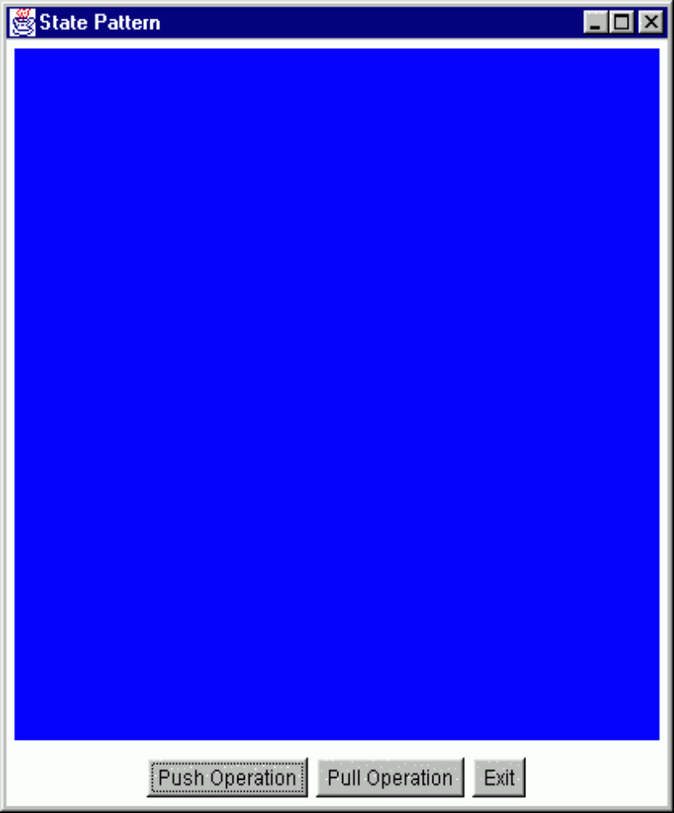
State Exercise 4: Color Changing Toy
Toy has 4 states:
  blue, black, green and red.
Two functions:
  push() and pull() changes the current state.
Blue state:
  push -> green state, pull -> red state
Black state:
  push -> red state, pull -> black state
Green state:
  push -> black state, pull -> blue state
Red state:
  push -> blue state, pull -> green state

Slide 41
State Exercise 4: Color Change Toy
We have 4 states:
  blue, black, green and red.
Two functions:
  push() and pull() changes the current state.
Blue state:
  push -> green state, pull -> red state
Black state:
  push -> red state, pull -> black state
Green state:
  push -> black state, pull -> blue state
Red state:
  push -> blue state, pull -> green state

Slide 42
State Exercise 4: Color Change Toy
We have 4 states:
  blue, black, green and red.
Two functions:
  push() and pull() changes the current state.
Blue state:
  push -> green state, pull -> red state
Black state:
  push -> red state, pull -> black state
Green state:
  push -> black state, pull -> blue state
Red state:
  push -> blue state, pull -> green state

Slide 43
Exercise 4: Solution
Toy
State
state variable
Push()
push()
Black State
Blue State
Red State
Green State
push()
Push()
Push()
Push()
Client
Allow an object to alter its behavior (dynamically bind to a different method) when its internal state changes.

Slide 44
Exercise 4: Solution
public abstract class State {
    public abstract void handlePush(Context c);
    public abstract void handlePull(Context c);
    public abstract Color getColor();
  }
public class BlackState extends State {
  public void handlePush(Context c) {
  c.setState(new RedState());}
  public void handlePull(Context c) {
  c.setState(new GreenState());}
  public Color getColor() {return (Color.black);}
  }

Slide 45
State Example Cont…
public class Context {
  private State state = null; // State attribute
  public Context(State state) {this.state = state;}
  public Context() {this(new BlueState());}
  public State getState() {return state;}
  public void setState(State state) {
  this.state = state;}
  public void push() {state.Push(this);}
}

Slide 46
Pros of State Pattern
Localizes state-specific behavior:
  Partitions behavior for different states into separate objects.
Makes state transitions explicit
  Obvious when moving from one state to another: as appropriate state class instance must be swapped in

Slide 47
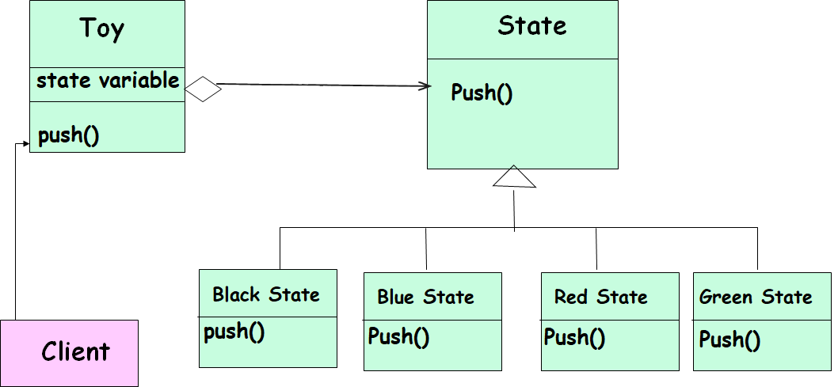
Question
Who creates the states that are taken on transitions?
PreferablyIncorporated into the ConcreteState classes
In the Context Class for simple cases

Slide 48
When are ConcreteState Objects Created?
Two options:
  Created as and when they are needed.
  Create once, used whenever needed: Context class uses it when needed.

Slide 49
Food for thought…
Where to define the state transitions ?
  For simple cases, transition can be defined in the context.
  More usable if transition is specified in the State subclass.
Whether to create State objects as and when required or to create-them-once-and-use-many-times ?
  First one is desirable if state changes are infrequent.
  Later one is desirable if the state changes are frequent.

Slide 50
Known Uses and Related Patterns
Several interactive drawing programs use the State pattern.
The Flyweight pattern makes it clear:
  When and how State objects can be shared.
State Objects are often Singletons.

Slide 51
Composite Pattern

Slide 52
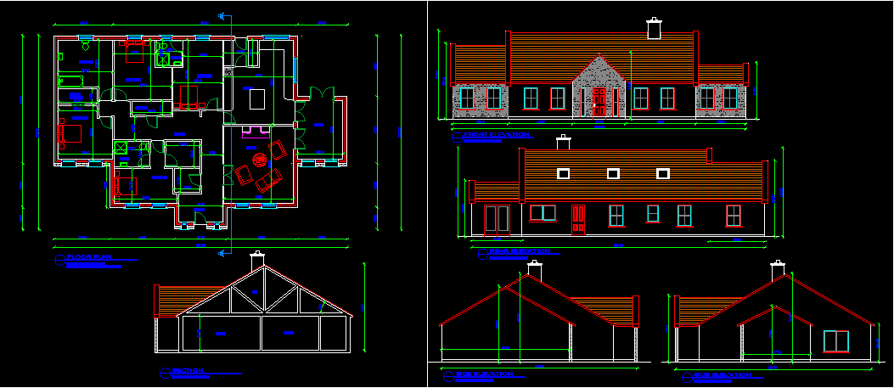
Composite: Introduction
A composite is a group of objects in which some objects contain others:
  An object may represent a group.
  Or may represent an individual item.
Example 1:A drawing---
t1 : Group
a : Leaf
b : Leaf
t2 : Group
c : Leaf
t3 : Group
e : Leaf
d : Leaf
e : Leaf

Slide 53
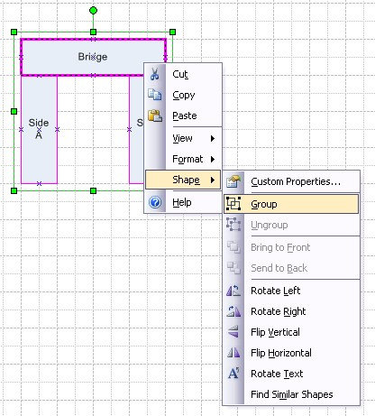
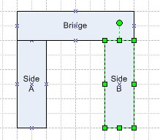
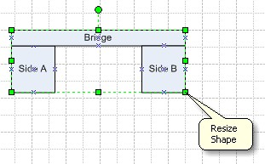
Example: Consider a Graphics Editor…
You can build complex diagrams using simple components
  Group components to form larger components...
  ...which in turn can be grouped to form still larger components

Slide 54
Composite Pattern: Intent
Compose a nested group of objects into a tree structure to represent part-whole hierarchies.
  Clients should be able to treat individual objects and compositions the same way.
t1 : Group
a : Leaf
b : Leaf
t2 : Group
c : Leaf
t3 : Group
e : Leaf
d : Leaf
e : Leaf

Slide 55
Why Composite Pattern? (Motivation)
What problems would occur if composite pattern is not used?
  Client code must treat primitive and container classes differently…
  Makes the application more complex.
  Additions of new components becomes troublesome…

Slide 56

Composite Solution: Attempt 1
Problem: handling nested groups of objects
Composite
*
Leaf
children
…
if X is Composite then
X.forall()
else X.operation();
...
forall()
operation()
Lets see a designer attempting to propose a class structure solution from scratch…
For all children c:
c.operation()
Analysis of Solution: Naïve solution…
What are the problems?
Only single nesting level (depth =1)
Composite and leafs always treated differently in code
-Difficult to extend with new kinds of leafs or composites.

Slide 57
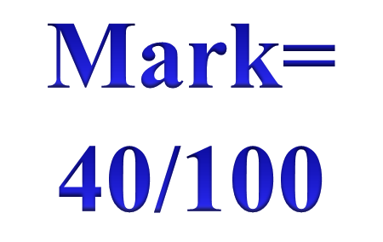
Composite: Attempt 2
Client:
children
*
item.operation()
Item
íf there are children then
for all children c: c.operation()
else doSomething();
operation()
Surely there are improvements…
Unified treatment in client and unrestricted depth of parts…
What are the problems?
-Does not handle different item types
-Difficult to extend with new kinds of leafs or composites.

Slide 58
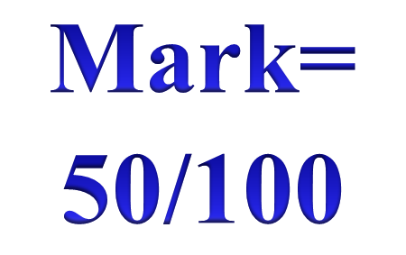
Attempt 3: Handling different Items
*
children
Item
operation()
New types of elements:
íf I have children then
for all children c: c.operation()
else doSomething1()
íf I have children then
for all children c: c.operation()
else doSomething2()
Item1
Item2
operation()
operation()

Slide 59
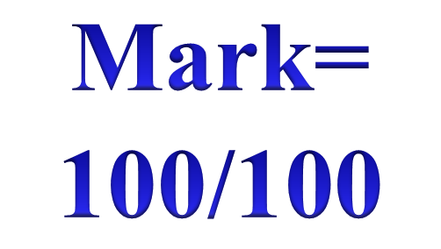
Finally: Composite Pattern
Separating the composite class:
children
*
Item
<<abstract>>
operation()
Item2
Item1
Composite
for all children c: c.operation()
operation()
operation()
operation()

Slide 60
Composite Design Pattern
Problem: How to organize hierarchical object structures so that the clients are not aware of the hierarchy?
Solution:
Item
*
operation()
children
Leaf
Composite
For all children c:
c.operation()
operation()
operation()

Slide 61
Composite Pattern: Issues
What is the class diagram?
Who is the client?
What operations are defined for:
  The component, the composite, and the leaf?
  How are they carried out?
How are associations implemented in the code?

Slide 62
Composite Pattern: Class Diagram
Client
Component
<Abstract>>
*
operation()
Leaf
Composite
operation()
operation()
other()
Each node of the Component structure can respond to some common operation(s).
The client can call operation of the Component and the structure responds “appropriately”.

Slide 63
Client
The client is any class that operates on the composite:
  It manipulates objects in the composition through the Component interface
Ex. VLSI CAD software
Client
Component
move()
add(Component)
remove(Component)

Slide 64
Component
Client
Component is an abstract class:
  Declares the interface for accessing and managing its child components
  Defines an interface for default behavior.
  Optionally provides access to the parent component
Component
<<abstract>>
*
operation()
Leaf
Composite
operation()
operation()
other()

Slide 65
Composite: Object Diagram
top : Composite
a : Leaf
b : Leaf
top : Composite
c : Leaf
top : Composite
e : Leaf
d : Leaf
e : Leaf

Slide 66
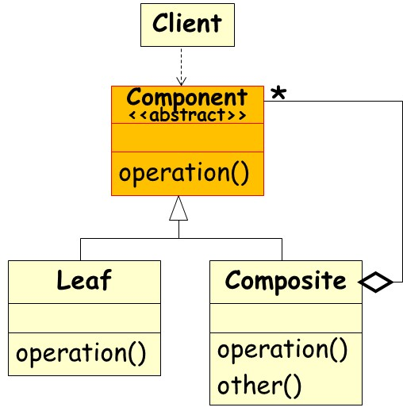
Other Participants
Leaf
  A leaf has no children.
  Defines behavior for primitive objects in the composition.
Composite
  Defines behavior for components having children.
  Stores child components.
  Implements child management methods.

Slide 67
Interaction with Clients
Clients use the Component class interface to interact with objects.
If the recipient is a Leaf:
  Then request is handled directly
If the recipient is a Composite:
  Forwards the request to child components

